Slide 1


Slide 2
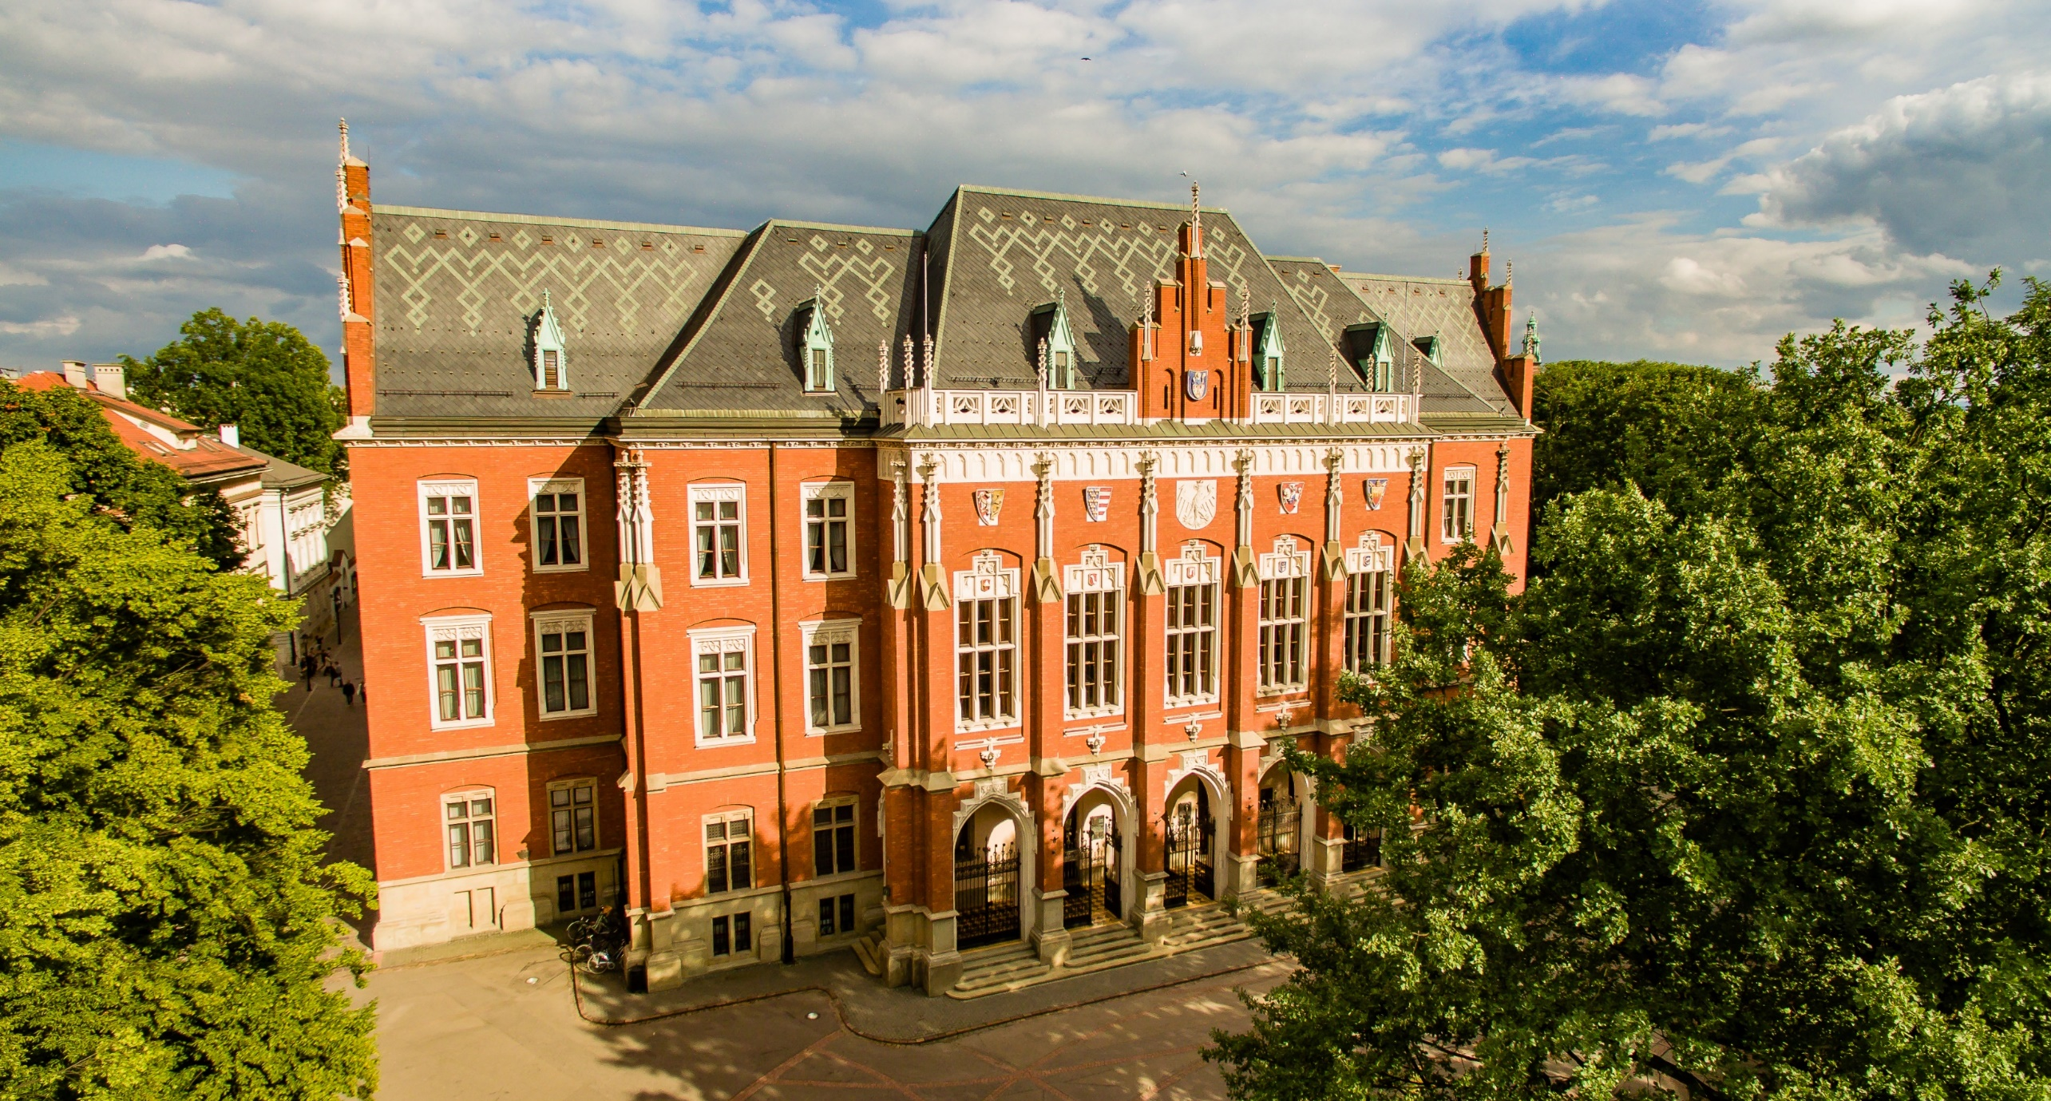
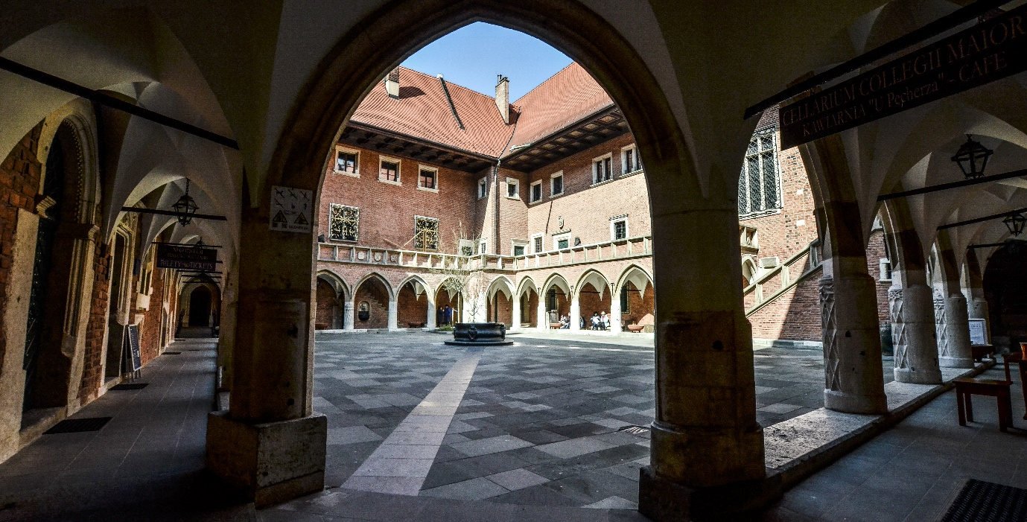

Jagiellonian
University
in Kraków
The oldest university in Poland
and one of the oldest in Europe
Founded in 1364 by the Polish King Casimir the Great, it was first called the ’Studium Generale’.
The modern name of the University was adopted in 1817.
en.uj.edu.pl

Slide 3


ONE OF THE BEST UNIVERSITIES IN POLAND
ONE OF THE LARGEST UNIVERSITIES
IN CENTRAL EUROPE
according to the ranking of the ’Perspektywy’ Education Foundation
A PLETHORA OF PROGRAMMES
FAMOUS STUDENTS AND ALUMNI
16 faculties and over 250 study programmes in Polish and English
Amongst the University’s most famous graduates are Nicolaus Copernicus and Pope John Paul II; Wisława Szymborska, Nobel Prize winner in literature,
also studied here
en.uj.edu.pl

Slide 4
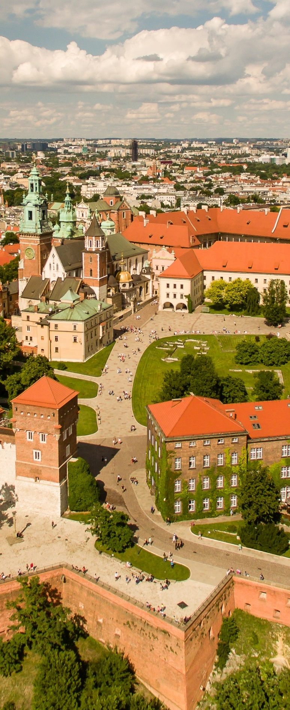
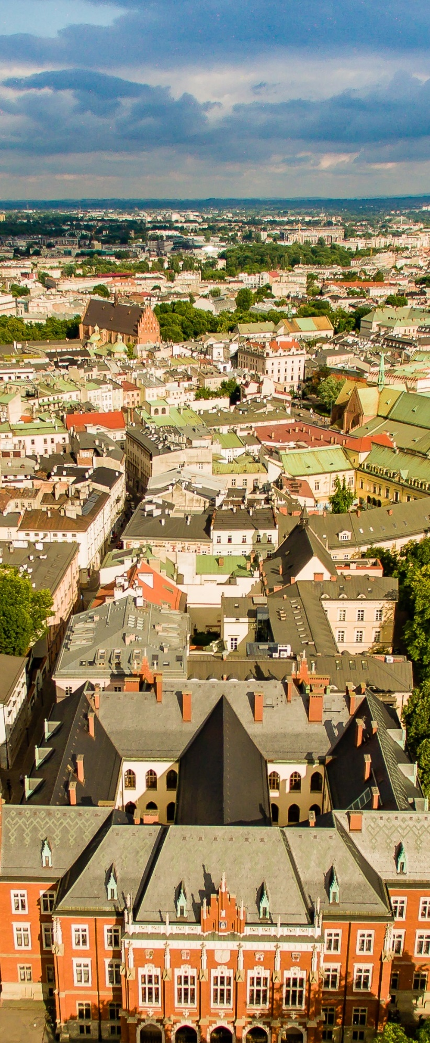
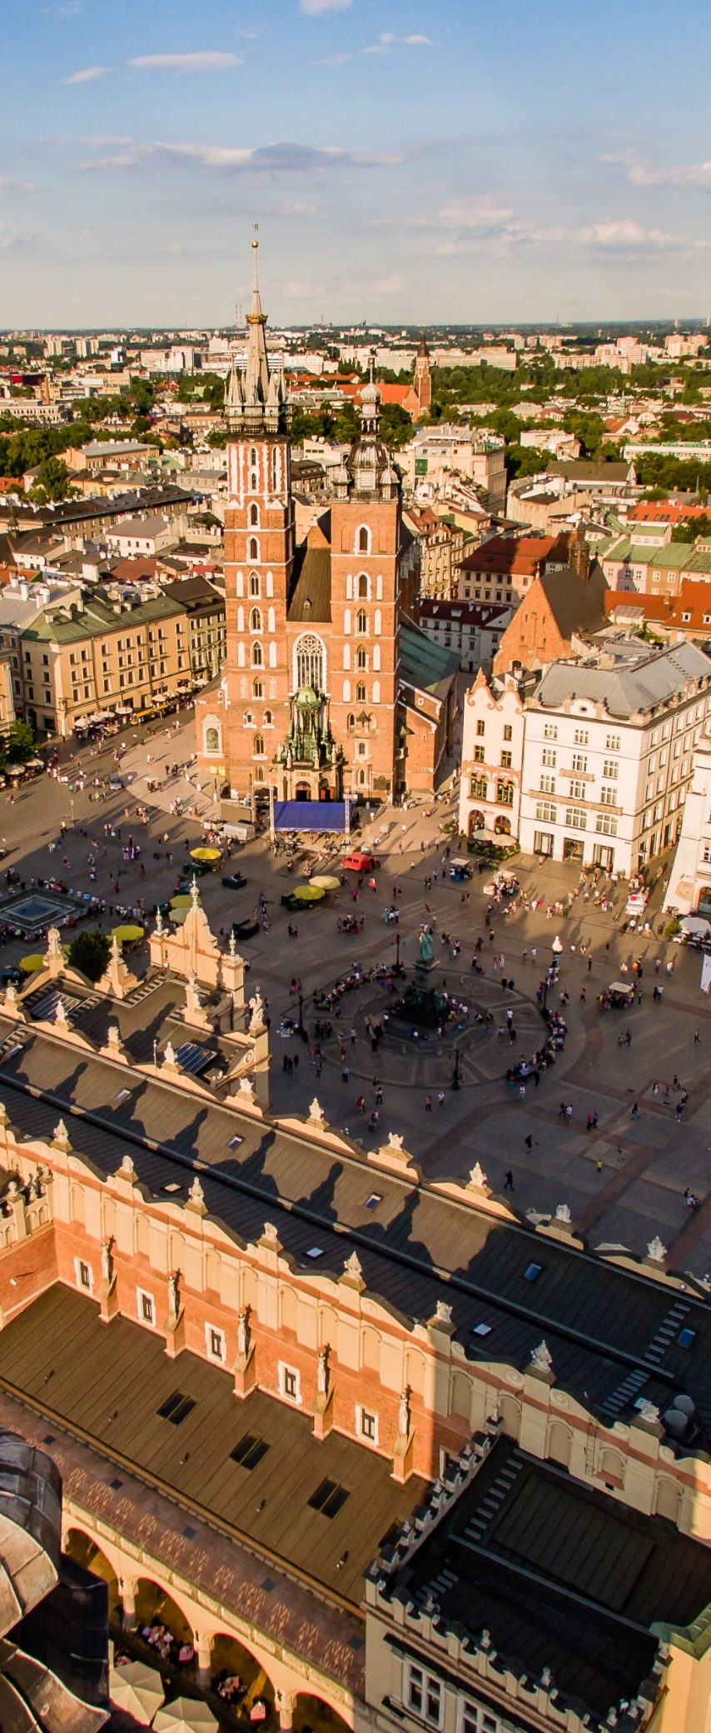
Kraków
a tourist gem of Europe
the cultural capital of Poland
the city of Polish kings
the city of a thousand galleries, museums and theatres
the city of writers, poets and artists
a centre for sports and tourism
en.uj.edu.pl

Slide 5

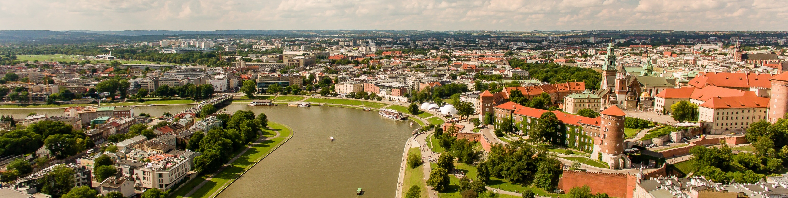
Kraków
is an academic
city
130,000 students,
of which almost one in four studies at the Jagiellonian University
18 higher education institutions
en.uj.edu.pl

Slide 6

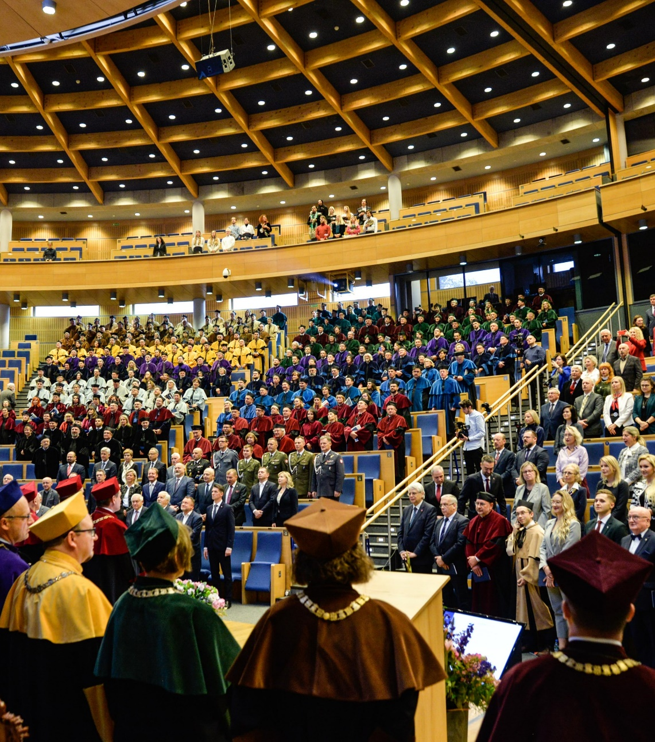
University
means People
over 35,000 STUDENTS, including almost 4,000 international students
over 9,000 EMPLOYEES, including 5,000 academic teachers
en.uj.edu.pl

Slide 7



Jagiellonian University
Excellence Initiative –
Research University
is a significant distinction which, combined
with achieving the status of a European University
within the framework of the Una Europa Alliance, contributes to the significant expansion of research activities and the prestige of the Jagiellonian University.
Research
University
In 2019, the University was granted
the status of Research University.
en.uj.edu.pl

Slide 8
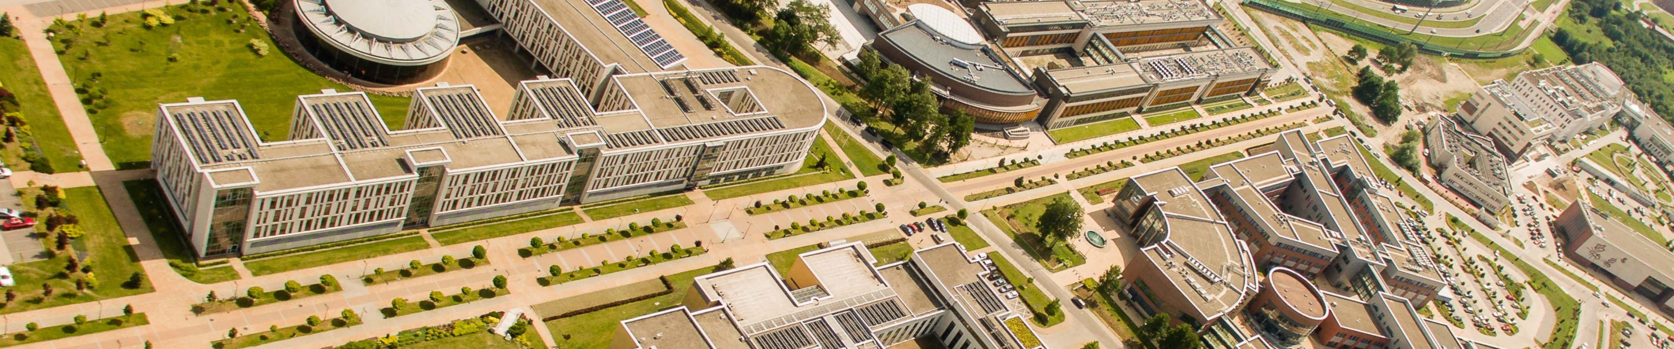
Achievements
One of the best
universities in the country
The highest ranked Polish university
according to the ranking of
the ’Perspektywy’ Education Foundation
in The Times Higher Education World University Ranking 2025
One of the highest ranked Polish universities
Distinguished university
in the Academic Ranking of World Universities 2025
European Research Council grant holder
in the QS World University Rankings: Sustainability 2025
also known as the Shanghai Ranking
en.uj.edu.pl

Slide 9

Faculty of Law and Administration
Faculty of Medicine
Faculty of Pharmacy
Faculty of Health Sciences
Faculty of Philosophy
Faculty of History
Faculty of Philology
Faculty of Polish Studies
Faculty of Physics, Astronomy and Applied Computer Science
Faculty of Mathematics and Computer Science
Faculty of Chemistry
Faculty of Biology
Faculty of Management and Social Communication
Faculty of International and Political Studies
Faculty of Biochemistry, Biophysics and Biotechnology
Faculty of Geography and Geology
Faculties of
the Jagiellonian University
en.uj.edu.pl

Slide 10


Study
programmes
Over 130
first-cycle and long-cycle
study programmes
Over 140
second-cycle study programmes
60
postgraduate study programmes
Over 30
study programmes in English
4
doctoral schools
en.uj.edu.pl

Slide 11
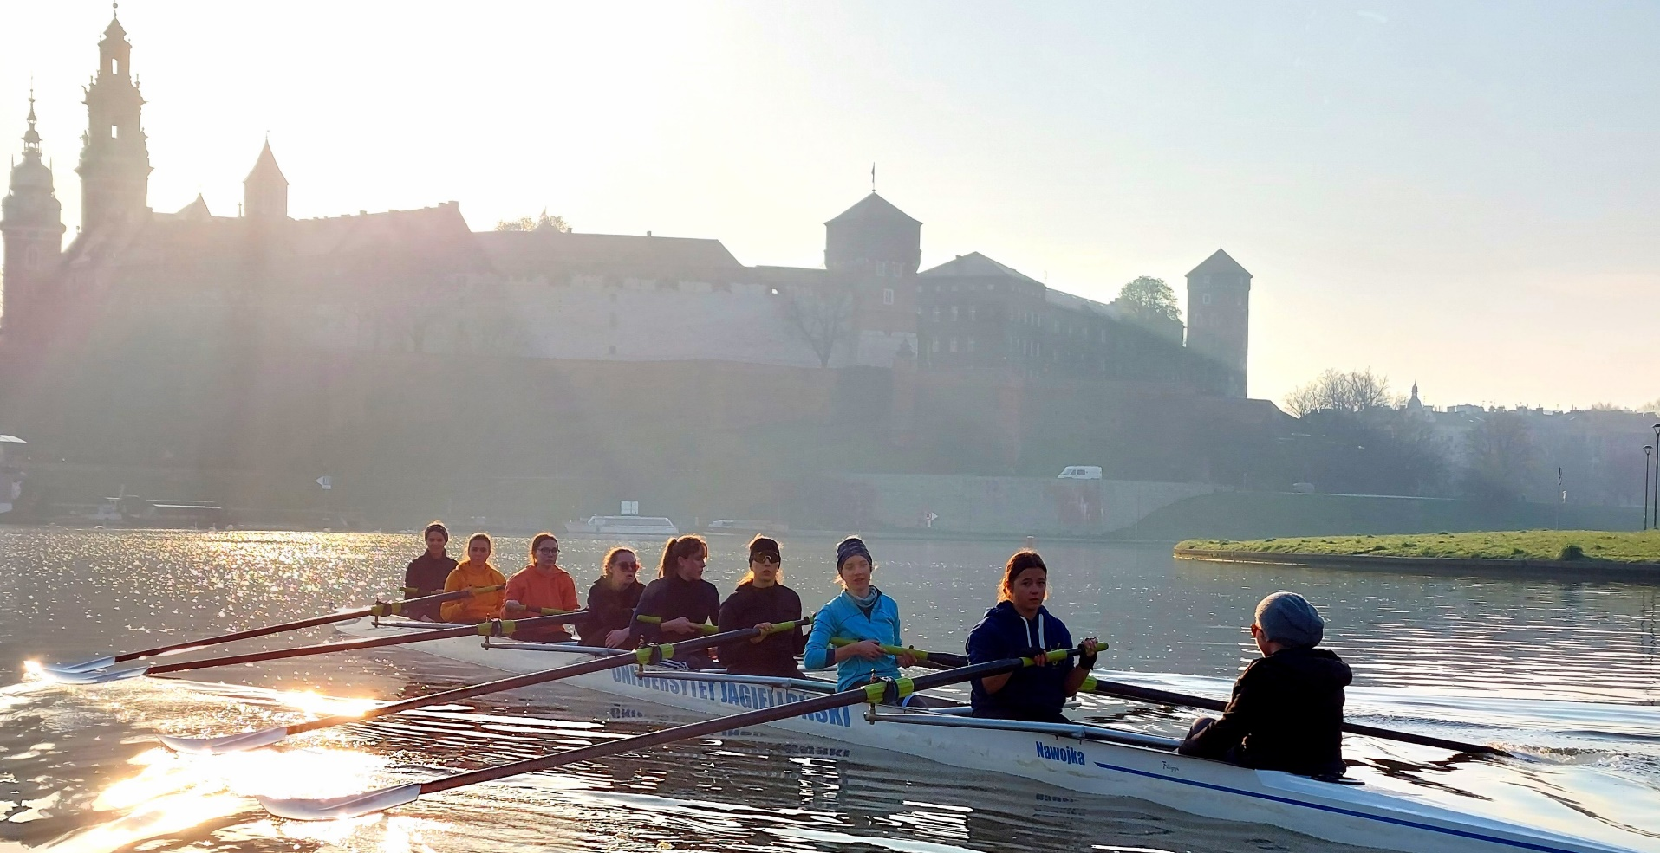

Student
activities
Over 300 student academic societies and organisations
’Słowianki’ Song
and Dance Ensemble
Student Government
’Camerata Jagellonica’ Academic Choir
UJOT FM
student radio
Academic Sports Association
UJOT TV
student television
en.uj.edu.pl

Slide 12



International cooperation
386 bilateral agreements
with universities in 76 countries
en.uj.edu.pl

Slide 13












12 cooperation networks
en.uj.edu.pl

Slide 14
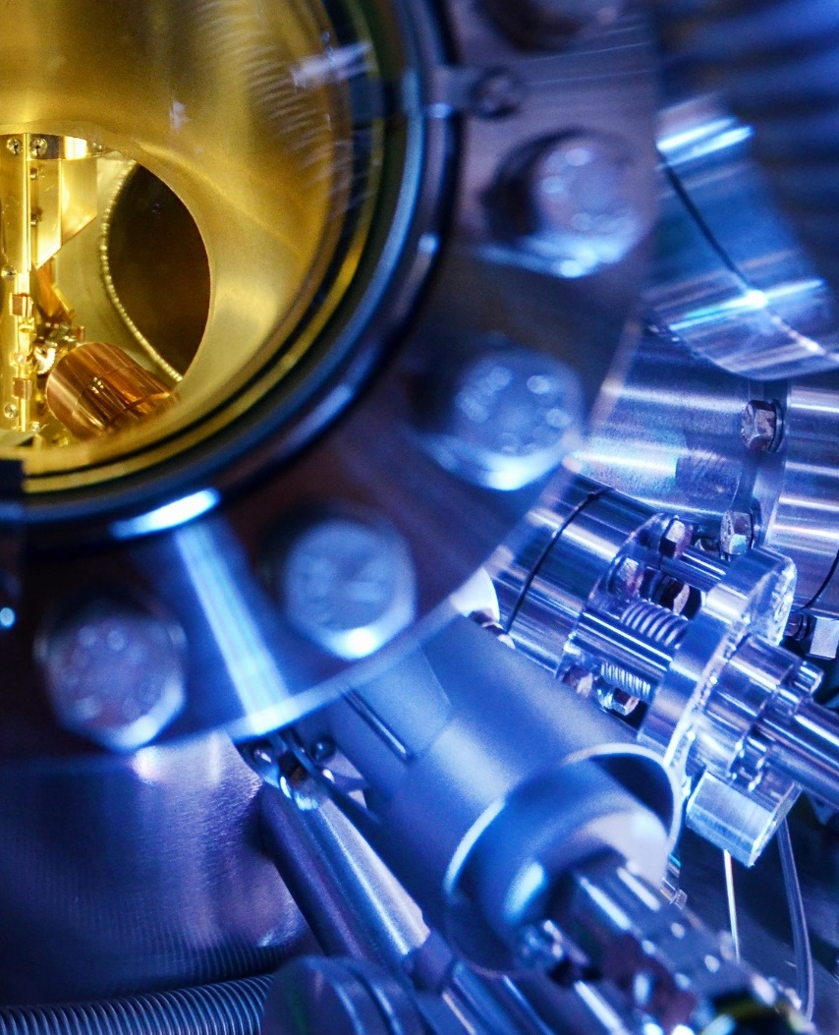
Science and research
The Jagiellonian University is home to
excellent, world-class research centres:
Małopolska Centre of Biotechnology (with the Max Planck Laboratory)
National Synchrotron Radiation Centre ’SOLARIS’
Jagiellonian Centre for Experimental Therapeutics
Copernicus Centre for Interdisciplinary Studies
Jagiellonian Centre of Innovation (Life Science Park)
University Hospital in Kraków
Centre for Brain Research
en.uj.edu.pl

Slide 15
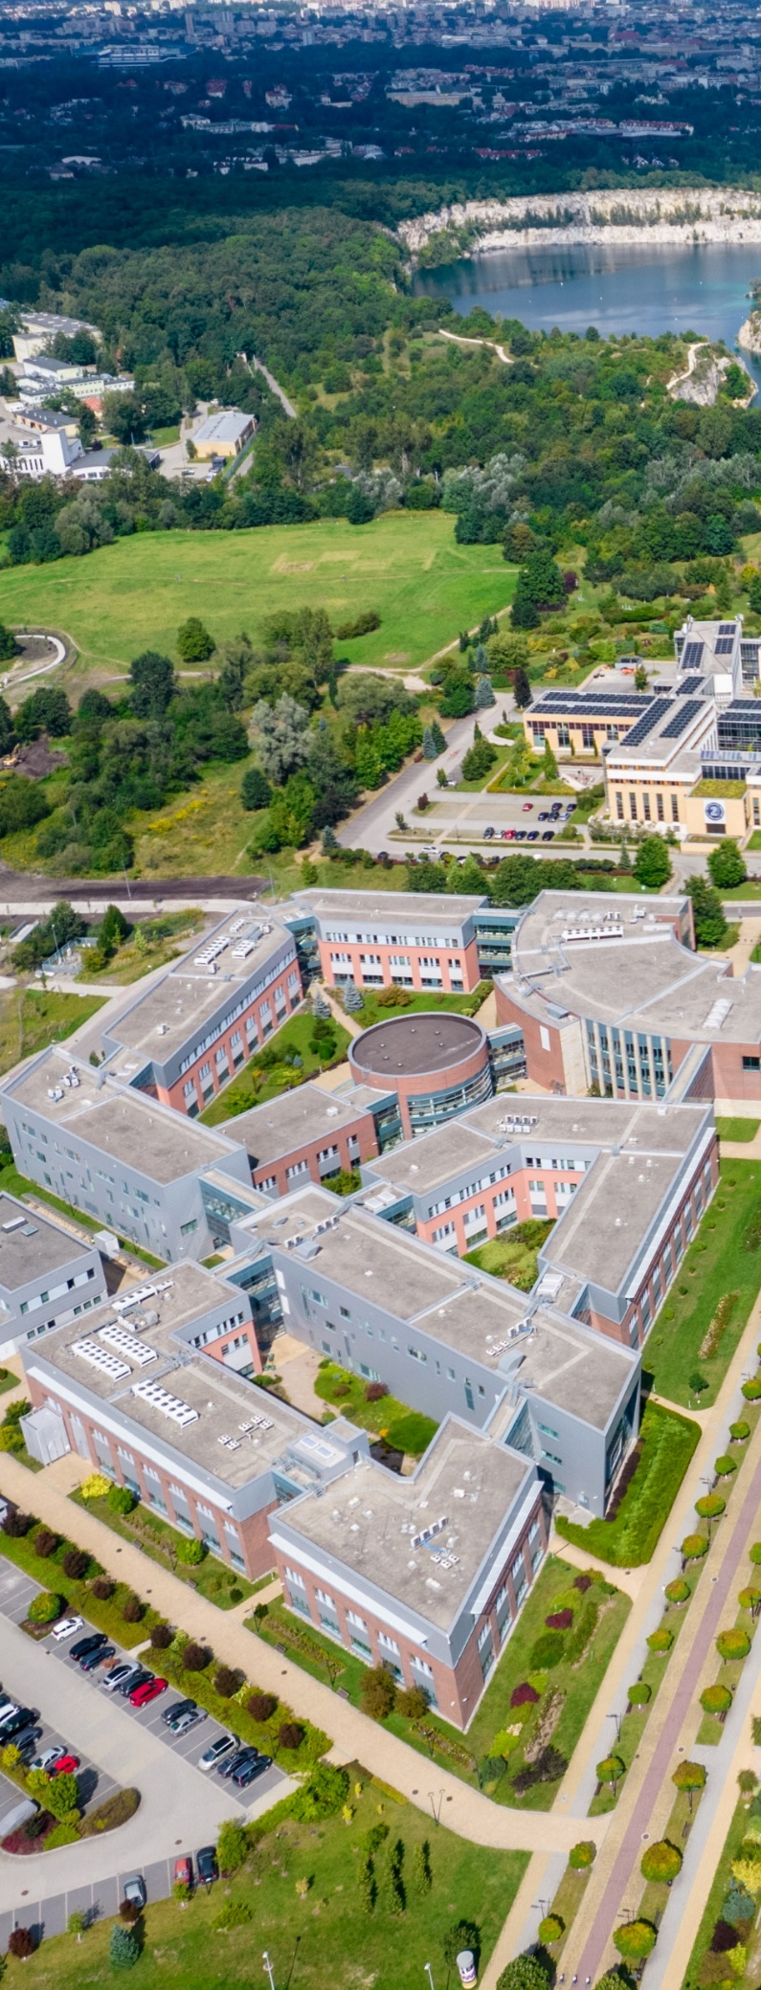
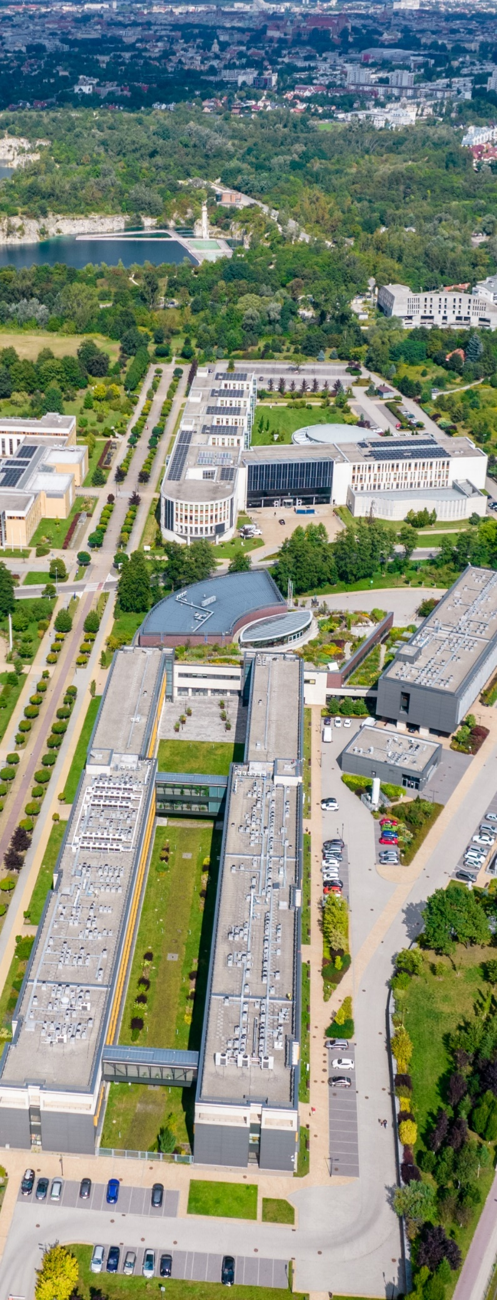
Campus of the 600th
Anniversary of the Jagiellonian University Revival
The campus is the most modern facility of this type in Poland, featuring cutting edge equipment.
It is home to all Jagiellonian University faculties of exact and natural sciences.
There are also other University units in the area:
Jagiellonian Centre of Innovation
Małopolska Centre of Biotechnology
JU Nature Education Centre
Jagiellonian Centre for Experimental Therapeutics
CITTRU Centre for Technology Transfer
National Synchrotron Radiation Centre ’SOLARIS’
en.uj.edu.pl

Slide 16


Research projects
In 2025, a total of over 1,661 projects were carried out
at the Jagiellonian University (including Medical College). The University received funding for the implementation
of 433 new projects worth almost 600 milion zlotys.
Projects, patents and inventions
in 2025
International projects
In 2025, 359 projects were implemented within the framework of various forms of international cooperation, including over 100 projects as part of the largest European research funding programmes: Horizon 2020
and Horizon Europe.
Patent protection
In 2025, the Jagiellonian University filed 25 patent applications in Poland and 32 abroad.
en.uj.edu.pl

Slide 17



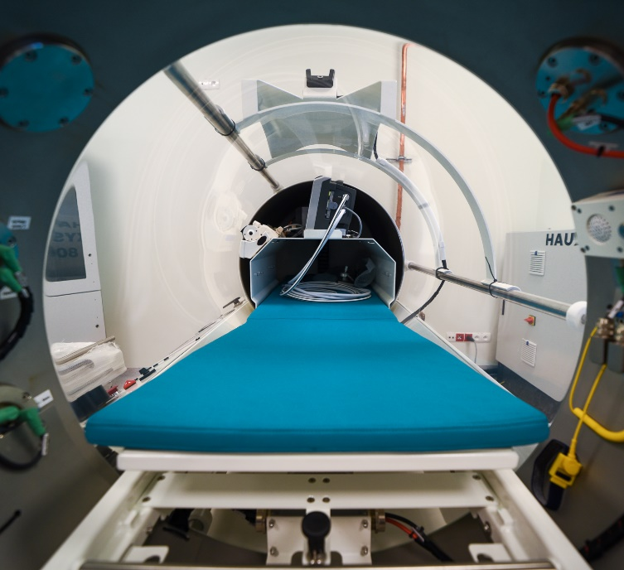
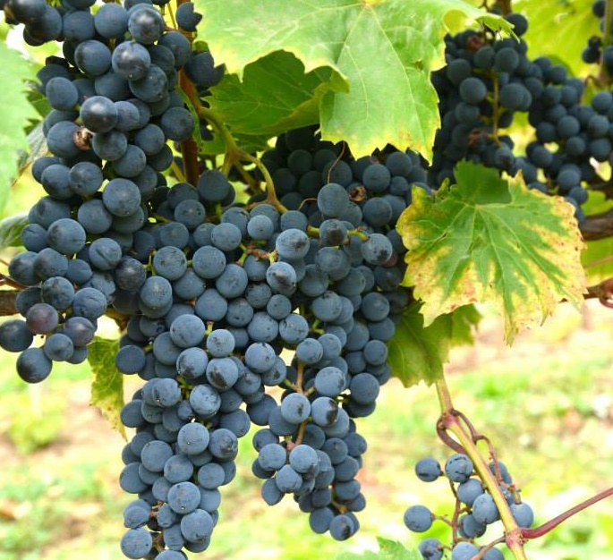
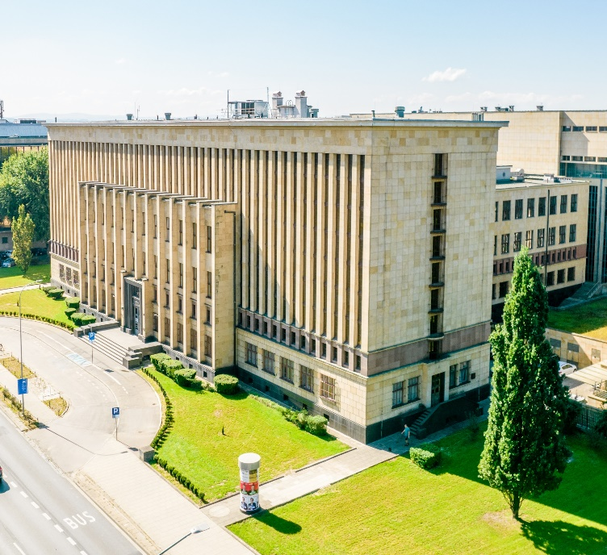
The Jagiellonian University is also
7 museums
Oldest
Botanical
Garden
in Poland
Astronomical Observatory
University Hospital
Vineyard
’On Manor Brook’
Jagiellonian Library
Named after Nicolaus Copernicus, founded
in 1792.
The largest medical facility in Poland
and this part of Europe with state-of-the-art equpiment.
Over 6 million books
and magazines.
The vineyard produces several types of wine which have been awarded at international competitions.
Founded in 1783.
en.uj.edu.pl

Slide 18
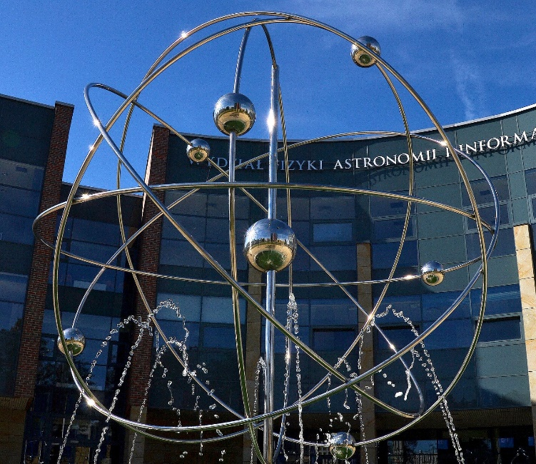



16 faculties
over 300
student academic societies and organisations
37 faculty libraries
and institutes
4 campuses
almost 300 fields of study
Over 660 years of academic tradition
over 35,000 students
over 350 international agreements
with universities
from all over
the world
12
international
cooperation networks
4 doctoral schools
over 9,000 staff
en.uj.edu.pl

Slide 19
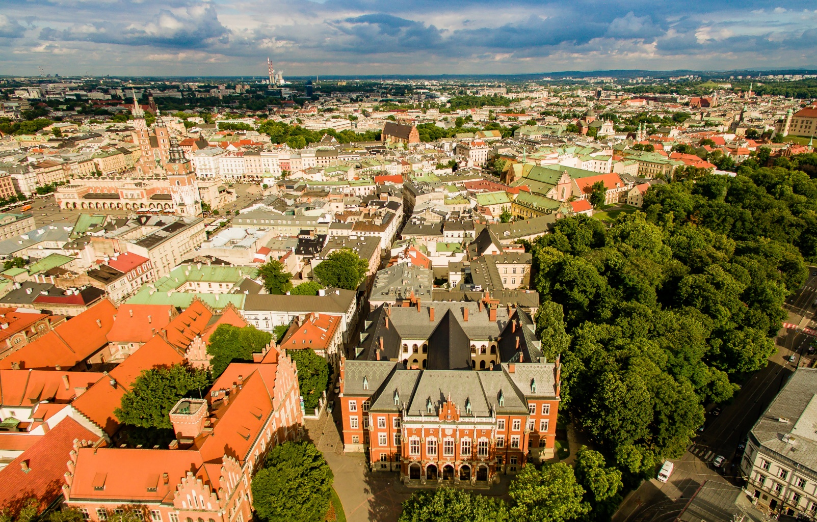

Bird’s eye view of the University
Worth
a watch
YOUR STORY
starts here
en.uj.edu.pl

Slide 20


Thank you!
en.uj.edu.pl
/jagiellonian.university
/jagiellonian_university
/unijagiellonski
* The data included in the presentation is from the academic year 2025/2026.
en.uj.edu.pl

